Slide 1

Skip The Line
cc: CucombreLibre - https://www.flickr.com/photos/33200530@N04

Slide 2

Who am I
cc: Alex Iby - https://unsplash.com/@ibydesigns?utm_source=haikudeck&utm_medium=referral&utm_campaign=api-credit
Notes:
test

Slide 3

Outline
Theme Park Tech
WebSockets
Observables
React.js Client
cc: KJGarbutt - https://www.flickr.com/photos/25187937@N05

Slide 4

Let's talk about themeparks
cc: Jason Chen - https://unsplash.com/@ja5on?utm_source=haikudeck&utm_medium=referral&utm_campaign=api-credit
Notes:
What is the worst part about going to a theme park?

Slide 5

Imagine a park where you accessed rides via a virtual line
cc: Leonrw - https://www.flickr.com/photos/28435348@N04

Slide 6
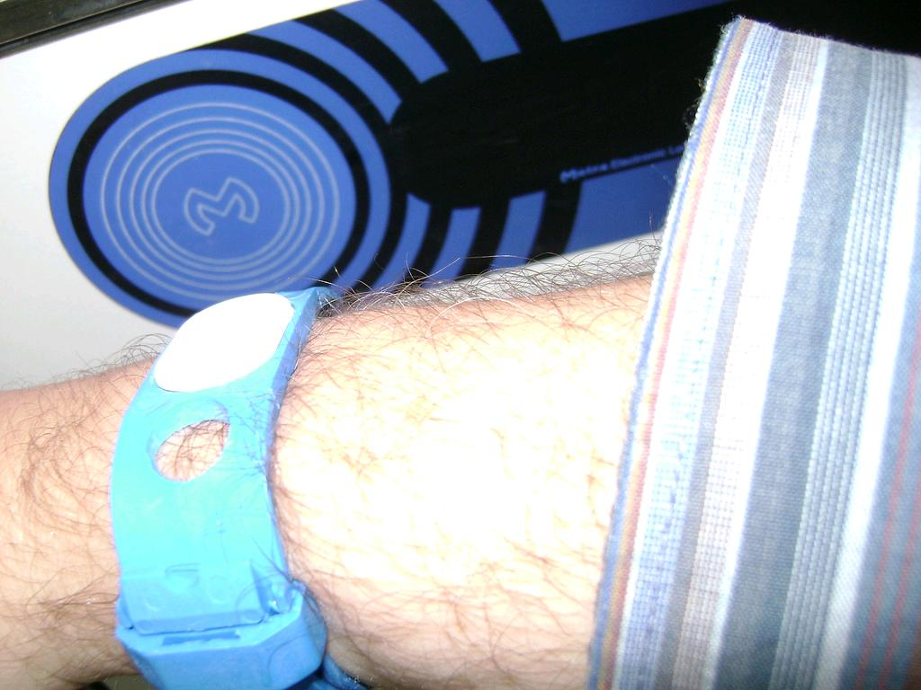
You touch a wearable device to a sensor and then go one your way
cc: Luc Van Braekel - https://www.flickr.com/photos/47211037@N00

Slide 7

Radio Frequency ID
Specs: ISO/IEC 15693, ISO/IEC 14443
Non-standardized: MiFare, Felica others
Notes:
Uses electromagnetic fields to active tag and share the data stored on the device

Slide 8
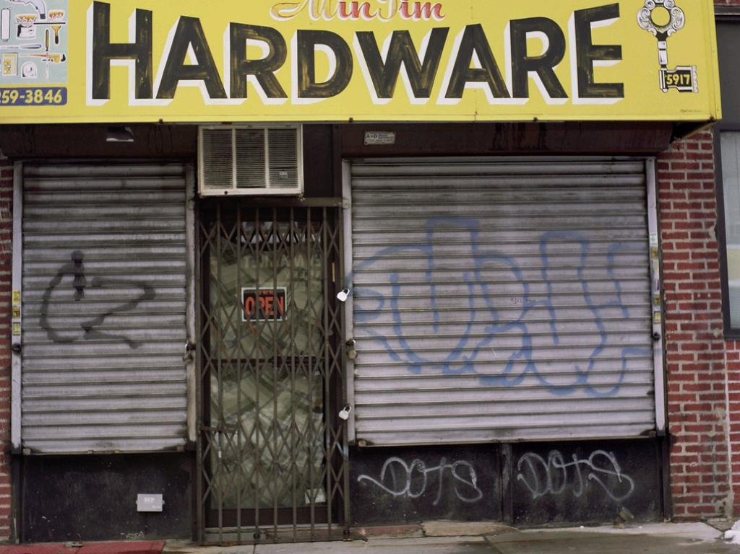
RFID IS COOL AND CHEAP!!
cc: 12th St David - https://www.flickr.com/photos/59816658@N00
Notes:
We’ll be using a device that shows up as an HID device (ie. Keyboard)

Slide 9
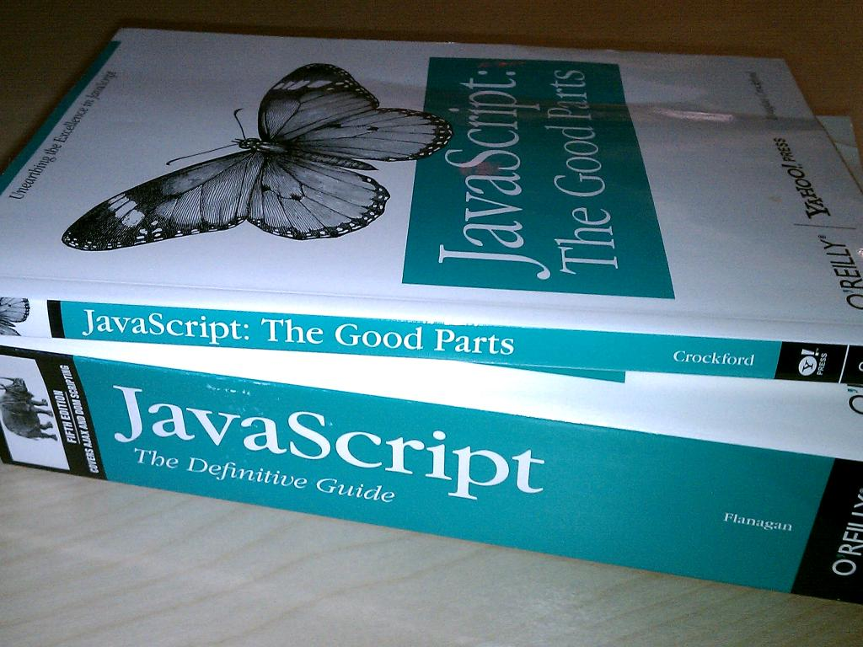
Time to build
cc: OÐ»ÑÐ³Ð° + HaÑaÐ½ - https://www.flickr.com/photos/42182644@N00
Notes:
Javascript WTF, big javascript node shop. Wanted web based as well.

Slide 10

How to notify our front-end when someone touches their wearable?
cc: Marcus Q - https://www.flickr.com/photos/41896843@N00

Slide 11
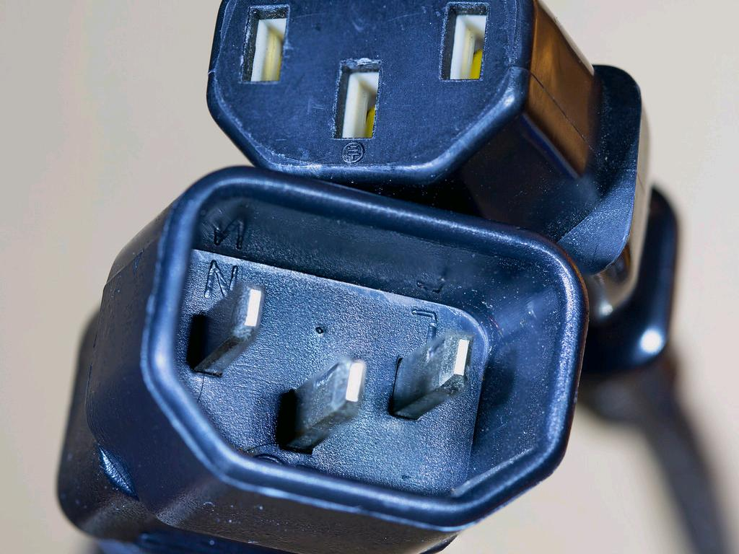
Lets Use WebSockets
cc: Carbon Arc - https://www.flickr.com/photos/41002268@N03

Slide 12

But Why?
cc: secretlondon123 - https://www.flickr.com/photos/25834786@N03

Slide 13
WebSockets
Bi-directional Stream
Socket.io, SignalR
All major browsers
Specs: RFC 6455

Slide 14
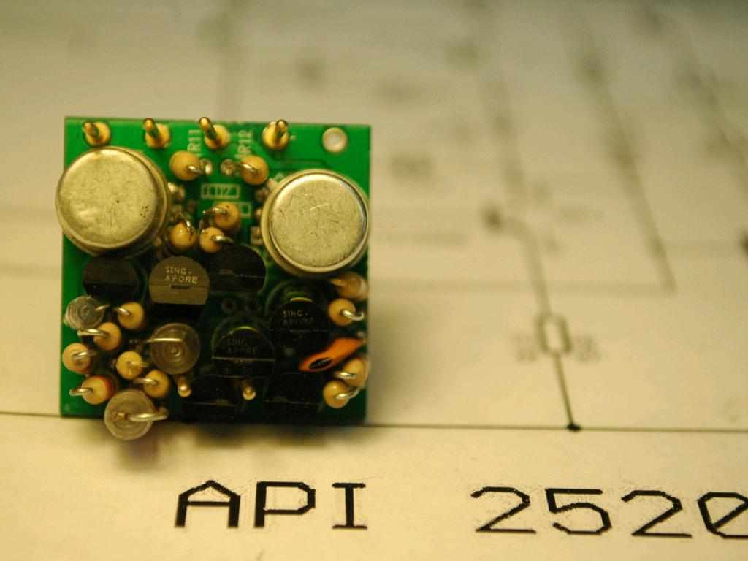
How will this work?
cc: 6SN7 - https://www.flickr.com/photos/47800690@N03

Slide 15
Design!
RFID
RFID
Reader
Notes:
User touches RFID media to RFID Reader

Slide 16
Design!
RFID
RFID
Reader
Node
Server
Notes:
RFID Reader sends that data to our server side application, this application will also serve up our simple website and our

Slide 17
Design!
RFID
RFID
Reader
Node
Server
Client-Side
JavaScript
Notes:
WebSocket connection sends a message to Javascript on the front-end that will show the data to the user of the application

Slide 18

Ok, let’s code it up
cc: Lord James [Web Developer] - https://www.flickr.com/photos/51098911@N07

Slide 19
Yarn
➜ rvajsconf2017-talk yarn add express
➜ rvajsconf2017-talk yarn add socket.io

Slide 20
Dependencies
const app = require("express")();
const http = require("http").Server(app);
const io = require("socket.io")(http);

Slide 21
Handling Input
let stdin = process.stdin;
stdin.resume();
stdin.on("data", key => { process.stdout.write(key);
io.emit("rfid", key);
});

Slide 22
Connections +
io.on("connection", function(socket) {
console.log("a user connected");
socket.on("disconnect", function() {
console.log("user disconnected");
});
});
app.get("/", function(req, res) {
res.sendFile(__dirname + "/index.html");
});
http.listen(3001, function() {
console.log("listening on *:3001");
});

Slide 23
Vanilla Front-End
<body>
<ul id="messages"></ul>
<script src="/socket.io/socket.io.js"></script>
<script>
let socket = io();
socket.on('rfid', function (msg) {
let decoder = new TextDecoder();
let decodedMessageText = decoder.decode(msg);
let message = document.createElement("li");
message.appendChild(
document.createTextNode(decodedMessageText)
);
document.querySelector("#messages").appendChild(message);
});
</script>
</body>

Slide 24

ok so we have a simple application that can send out messages to all users of this socket.io endpoint
cc: MARK ADRIANE - https://unsplash.com/@markadriane?utm_source=haikudeck&utm_medium=referral&utm_campaign=api-credit
Notes:
Transition into discussion of the react and observer pattern. People don’t actually use vanilla javascript on the clint-side

Slide 25
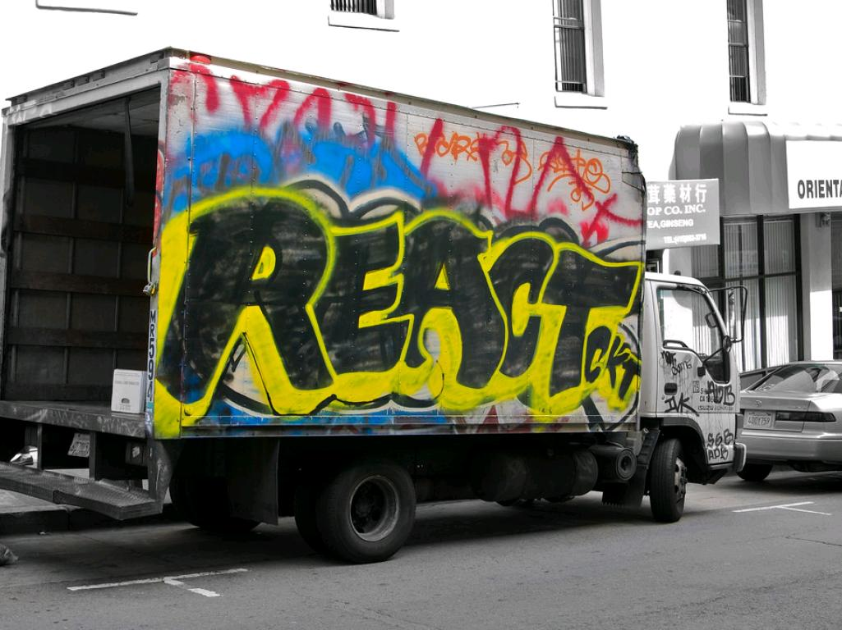
Enter in your Front-End Tooling of Choice
cc: Louis Abate - https://www.flickr.com/photos/25132305@N05
Notes:
Discuss create-react-app

Slide 26
Why React?
Component Based
Just our view layer
Simple to Reason about

Slide 27
Create React App
➜ rvajsconf2017-talk git:(master) ✗ create-react-app thempark-ride

Slide 28
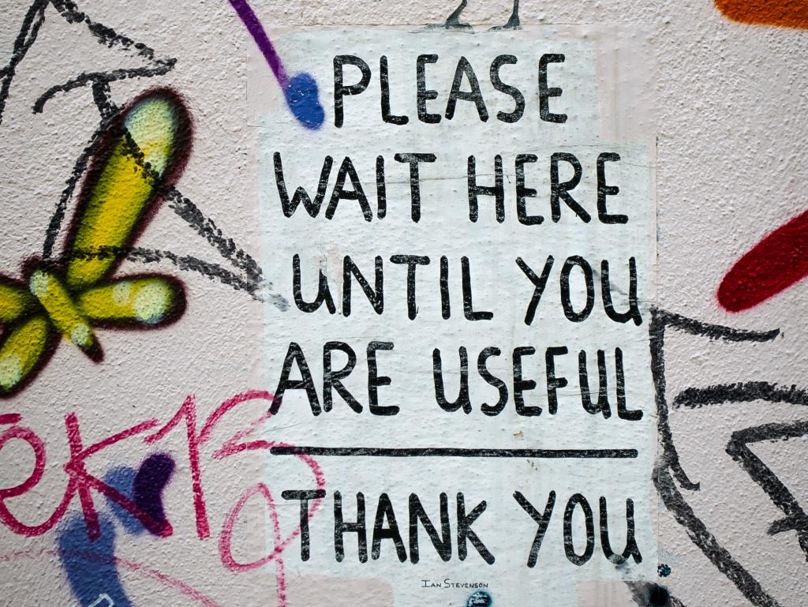
How should we handle the Socket.io messages?
cc: garryknight - https://www.flickr.com/photos/8176740@N05
Notes:
Updating our create react apps state

Slide 29

Observer Design Pattern
cc: Samuel Zeller - https://unsplash.com/@samuelzeller?utm_source=haikudeck&utm_medium=referral&utm_campaign=api-credit
Notes:
Discuss observer and subjects

Slide 30
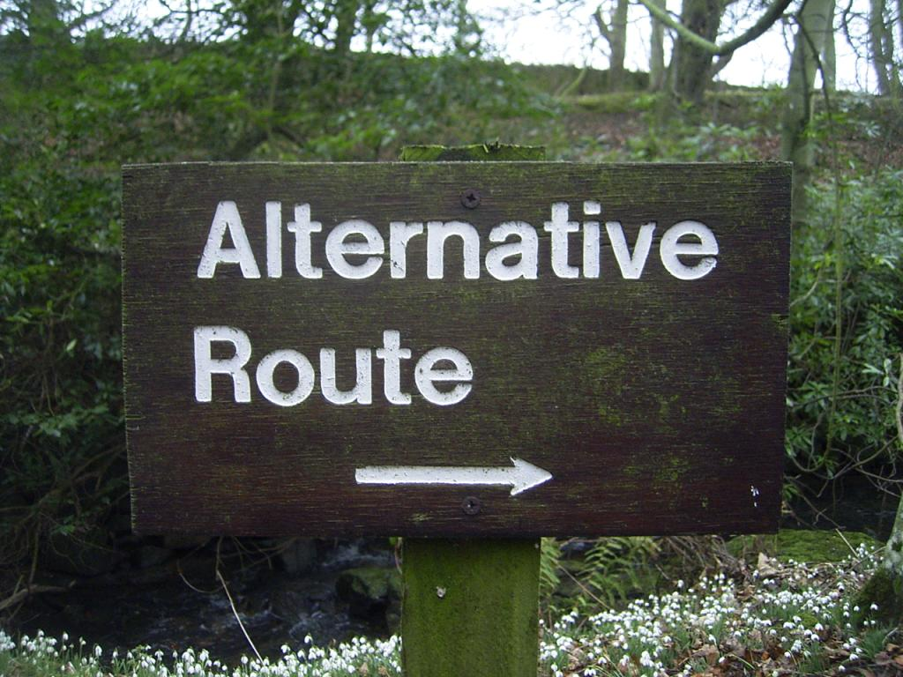
cc: duncan - https://www.flickr.com/photos/34427470616@N01
Notes:
there are several different design patterns that might be used to accomplish this same behavior

Slide 31
Observables vs. Promises
Handle multiple events
Cancellable
Simple to Reason about

Slide 32

javascript doesn't have an observable yet but there is a proposed spec
cc: mag3737 - https://www.flickr.com/photos/50318388@N00

Slide 33
Observables Spec
https://github.com/tc39/proposal-observable

Slide 34

Let's use a library that has an Observerable implementation
cc: wonderfully complex - https://www.flickr.com/photos/41598237@N00

Slide 35

Enter Rxjs
cc: Mr.Tea - https://www.flickr.com/photos/12575062@N00
Notes:
Reactive extensions

Slide 36

I was originally going to discuss using redux here but I think that would just confuse things
cc: Ò® - https://www.flickr.com/photos/7811493@N07

Slide 37

lets build out a front-end
cc: mkhmarketing - https://www.flickr.com/photos/93212162@N08

Slide 38
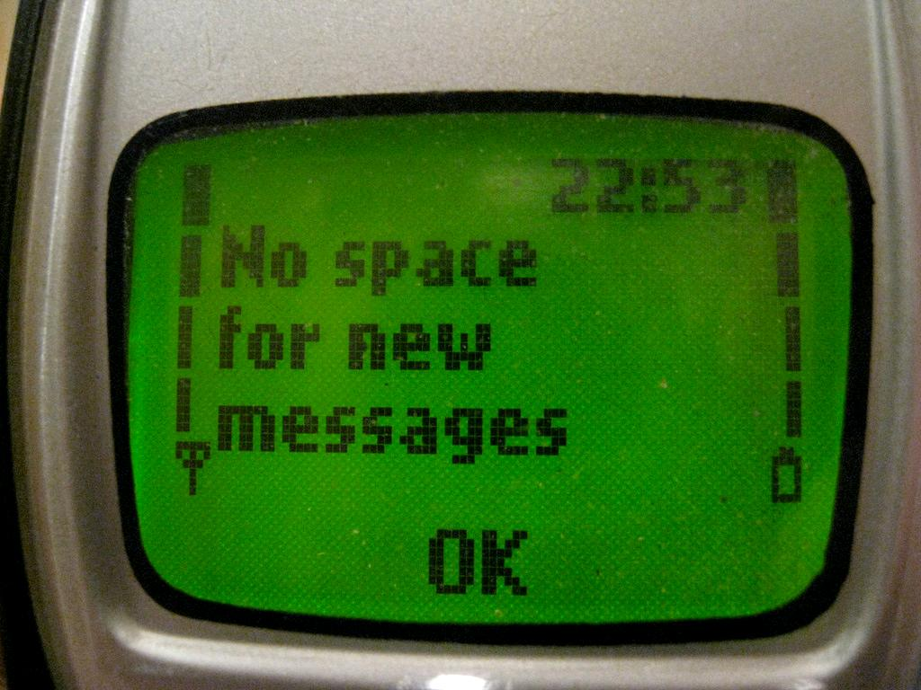
Rxjs observable will emit a message when a Socket.io event is fired
cc: mangee - https://www.flickr.com/photos/64937321@N00

Slide 39
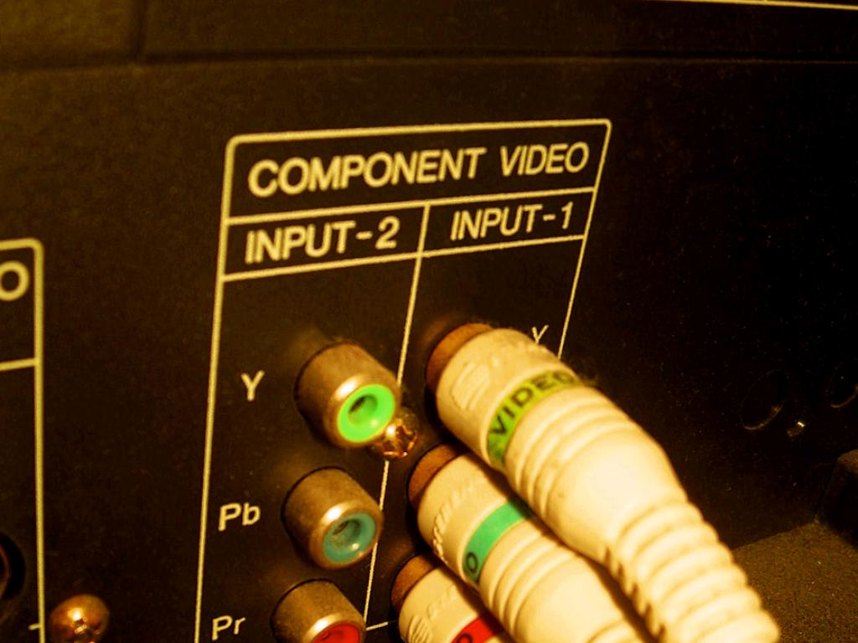
React component state will be updated
cc: Pete Prodoehl - https://www.flickr.com/photos/35237092540@N01

Slide 40
Let’s add this to our create react app
cc: Lord James [Web Developer] - https://www.flickr.com/photos/51098911@N07

Slide 41
Socket Client
constructor(props) {
super(props);
const socket = openSocket("http://localhost:3000");
socket.on("rfid", function(msg) {
let decoder = new TextDecoder();
let decodedMessageText = decoder.decode(msg);
console.log(decodedMessageText);
});
}
Notes:
A simple integration by adding to the App.js component constructor to handle the connection

Slide 42
Refactor in Observable
let that = this;
this.state = { rfids: [] };
const socketObservable = Rx.Observable.create(observer => {
const socket = openSocket("http://localhost:3000");
socket.on("rfid", function(msg) {
let decoder = new TextDecoder();
let decodedMessageText = decoder.decode(msg);
observer.next(decodedMessageText);
});
});
socketObservable.subscribe(val => {
let rfids = that.state.rfids;
rfids.push(val);
that.setState({ rfids: rfids });
});
Notes:
A simple integration by adding to the App.js component constructor to handle the connection

Slide 43
Render!!
<ul>
{this.state.rfids.map((rfid, i) => {
return <li key={i}>{rfid}</li>;
})}
</ul>
Notes:
A simple integration by adding to the App.js component constructor to handle the connection

Slide 44

What we learned
cc: Anne Davis 773 - https://www.flickr.com/photos/46353871@N00
Notes:
Handling of real-time events. Some different approaches

Slide 45
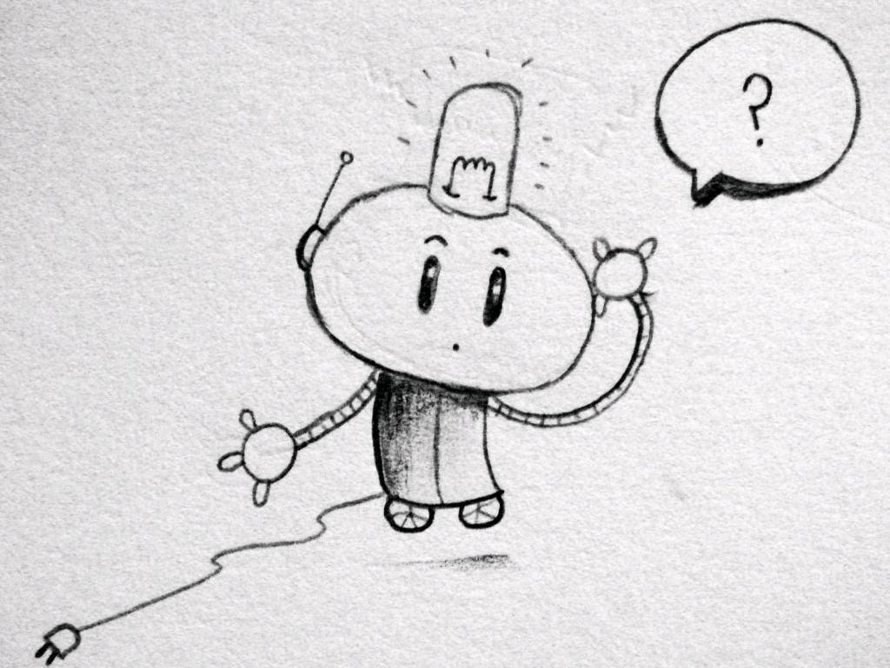
Q & A
cc: matt hutchinson - https://www.flickr.com/photos/17524395@N00

Slide 46
Materials
https://github.com/joshsticks/rvajsconf2017-talk
Notes:
A simple integration by adding to the App.js component constructor to handle the connection

